Slide 1
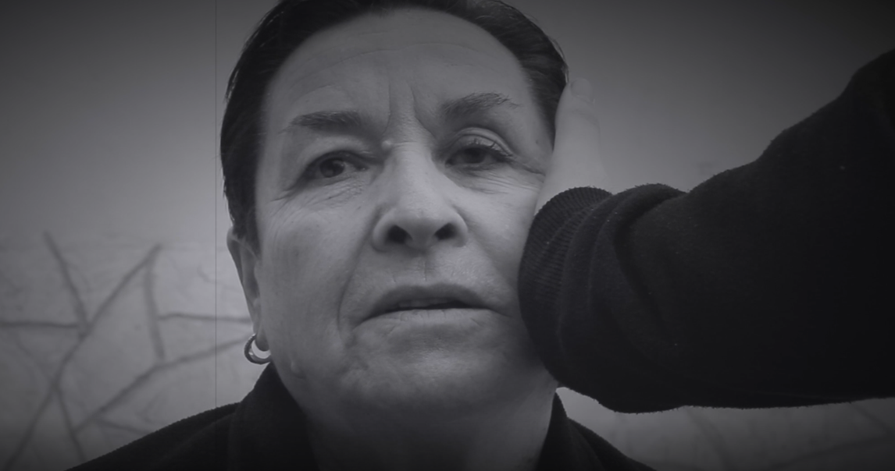
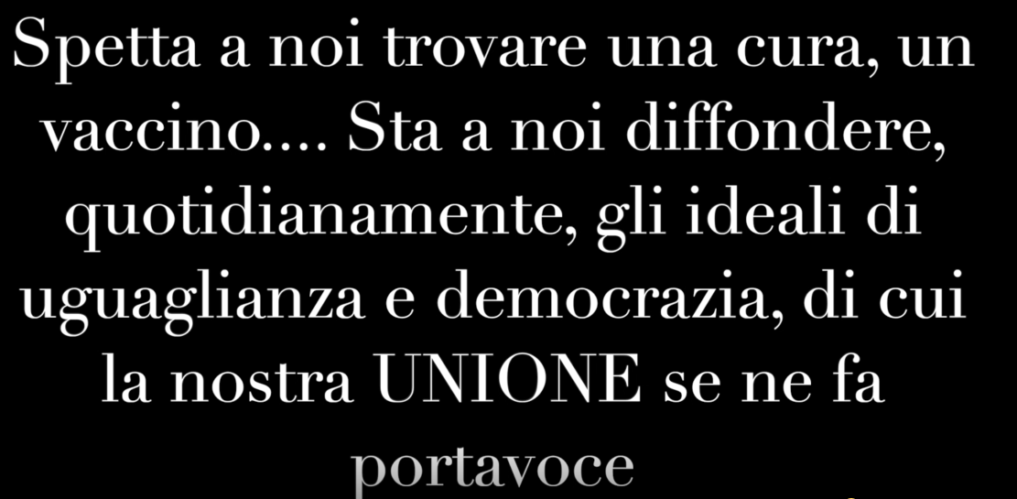
5B LS CAPPELLI-DI VITO-NIGLIO: I giovani ricordano la Shoah
https://youtu.be/Uqf7ELY97qA

